Slide 1
Lecture LA03: Master Page, CSS and Bootstrap 3.0
ITP271 :: Web Application Development & Project

Slide 2
Contents
Master Pages
Web Site Navigation
Cascading Style Sheets
Bootstrap

Slide 3
Introduction
A well design web site will have a consistent look and feel such as :
  A common header and menu system for entire site
  A bar on the left side for navigation
  A footer providing copyright information
Instead of duplicating the above features on every web page, a better approach would be to define them in a template, and have web pages use these templates.
  In ASP.NET, these templates are called Master Pages.

Slide 4
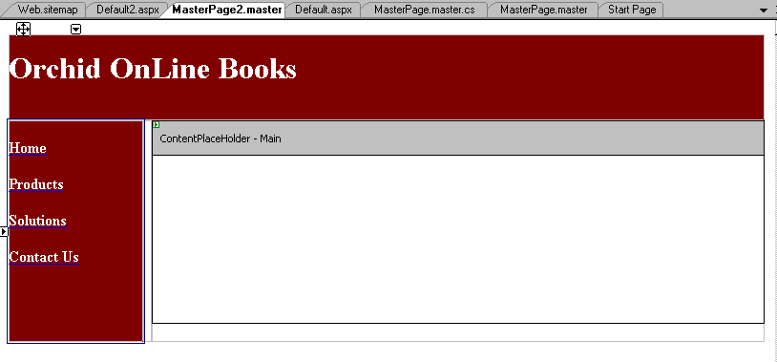
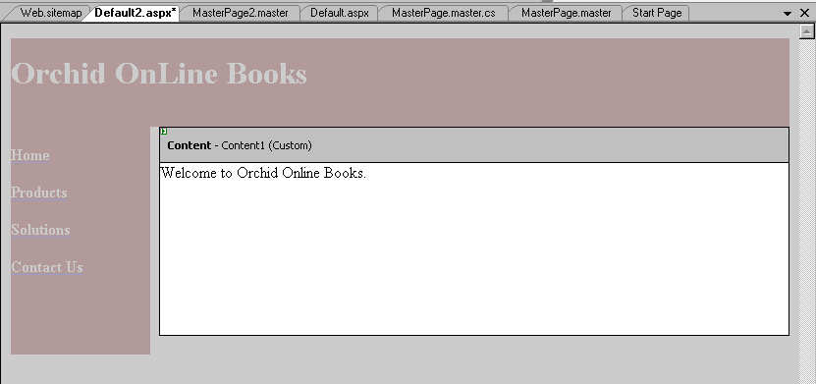
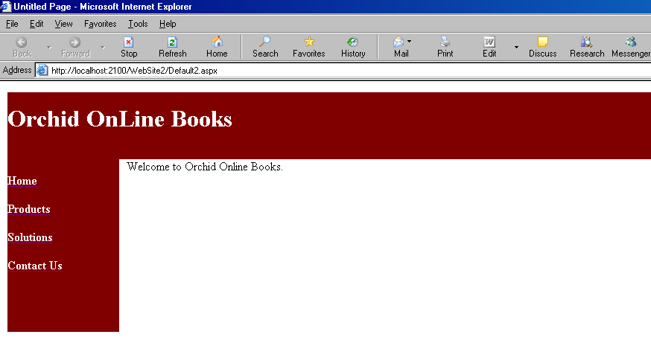
How a Master Page works
Define a Master Page which contains common elements for entire web site
Reference to Master Page from ASPX pages
1
2
3
Resulting output in browser

Slide 5
How a Master Page works
Areas where the custom contents of the ASP.NET Web Pages are to appear are marked out or 'reserved' by ContentPlaceHolder controls.

Slide 6
How a Master Page works
Master Pages can be nested.
  I.e. a Master Page can also have a Master Page
  This allows for one main Master Page that has the Headers and Footers, and additional child Master Pages for different sections of the website.
When a new Master Page is created, by default, only 2 ContentPlaceHolders are created:
  One for the head element of the page
  One for the body element of the page
However, additional ContentPlaceHolders may be created in the same Master Page.

Slide 7
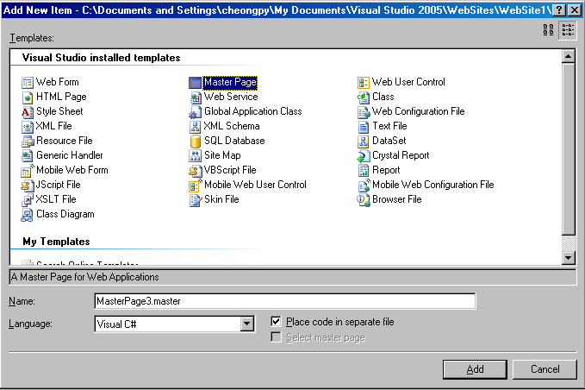
How to create a Master Page
Choose Web Site→ Add New Item-→Master Page

Slide 8
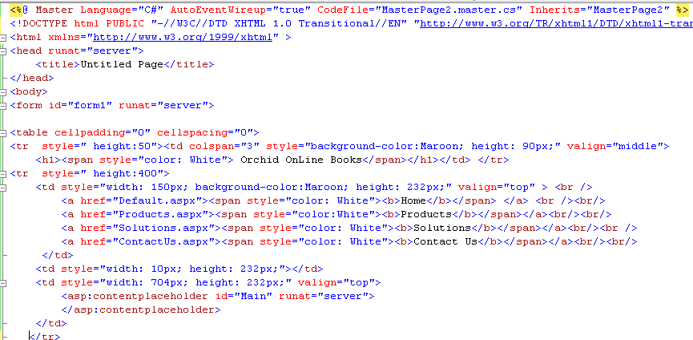
Codes generated in a Master Page
Code starts with a Master directive
ContentPlaceHolder is where contents from Content Pages is placed at runtime

Slide 9
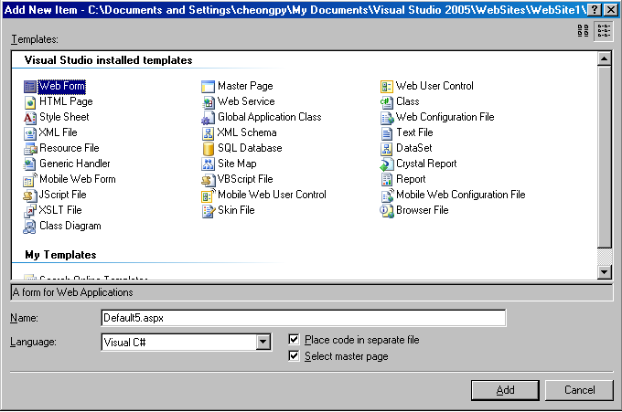
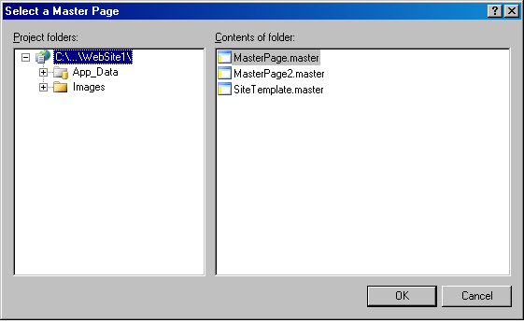
How to create a Content Page
A content page is actually just a normal aspx Web Form
Select one of the Master Pages to be associated with the Web Form
Make sure this is checked

Slide 10
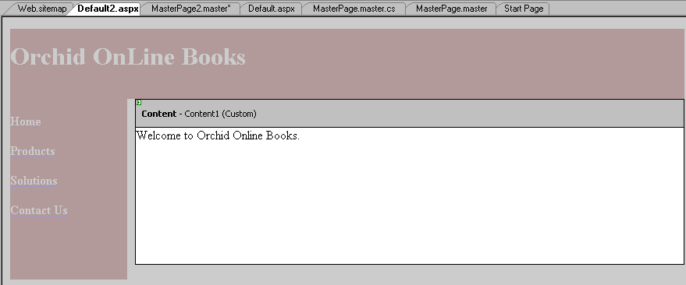
How to create a Content Page
Master Page is dimmed and cannot be edited in a Content Page
This Content element is associated with the ContentPlaceHolder of the Master Page
Text entered within this Content will apppear within the content start and end tags

Slide 11
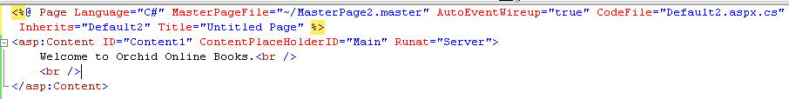
Codes generated in a Content Page
Master Page associated with this Page
This Title will over ride that defined in Master Page
This is the ID defined for the ContentPlaceHolder in the Master Page

Slide 12
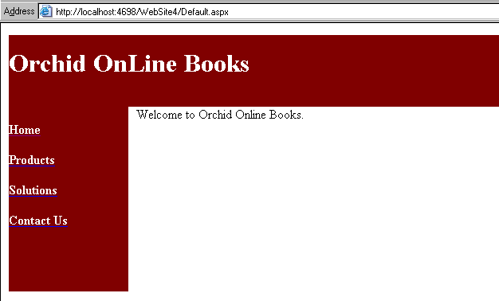
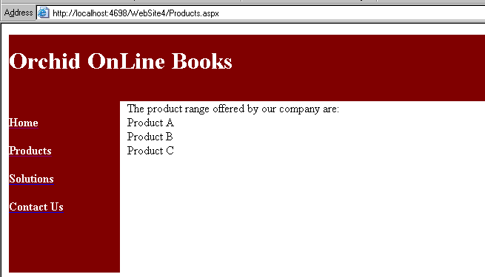
Example
Two web forms (Default.aspx and Products.aspx referencing the same Master Page)
Default.aspx
MasterPage2.Master
Products.aspx

Slide 13
Masterpages explained in 10 minutes
https://www.youtube.com/watch?v=33sBZanzlII

Slide 14
Cascading Style Sheets

Slide 15
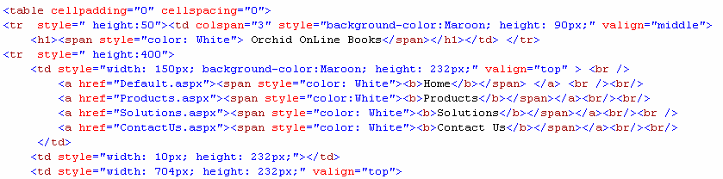
Introduction
Earlier, we have seen tables and other elements such as span being formatted individually.
This leads to maintenance problems; A better approach is to keep such formats and styles externally in a Cascading Style Sheet file

Slide 16
What are Cascading Style Sheets?
Cascading Style Sheets (CSS) is a standard defined by W3C, and not an ASP.NET technology.
CSS is a mechanism for adding styles (such as fonts, colours, spacing) to web pages
CSS is bandwidth friendly; A Single CSS file can control the appearance of thousands of web pages

Slide 17
CSS Basics
Syntax
  The CSS syntax is made up of three parts: a selector, a property and a value:
  Examples:
    body {color: black}
    p {font-family: "sans serif"}
    p {text-align:center;color:red}
attribute to set
selector {property: value}
normally the HTML element/tag
value of property
If the value is multiple words, put quotes around the value
If more than one property is defined, separate each property with a semicolon.

Slide 18
CSS Basics
Inheritance
  When one element is nested inside another, the nested element will inherit the properties assigned to the containing element.
body {font-family: Verdana, serif;}
A font declared in the body will be inherited by all text, unless another font is declared for a specific nested element
h1 {font-family: Georgia, sans-serif;}
  All <h1> tags will be set to Georgia, leaving text within other elements unchanged from the body declaration of Verdana.

Slide 19
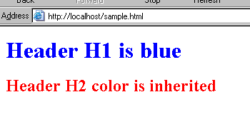
Example
<html>
<head>
<link rel="stylesheet"
type="text/css" href="sample.css" />
</head>
<body>
<h1>Header H1 is blue</h1>
<h2>Header H2 color is inherited</h2>
</body>
</html>
H1 color property is defined in CSS while H2 color property is inherited from color property of Body
Sample.html
body {color: red}
h1 {color: blue}
Sample.css

Slide 20
CSS Basics
Class Selector
  A Class Selector allows different styles to be defined for the same HTML element
p.left {text-align: left}
p.center {text-align: center}
Same element but one is left aligned while another is centre aligned
<p class=“left">Left-aligned.</p>
<p class="center">Center-aligned.</p>

Slide 21
CSS Basics
Grouping
  Selectors can be grouped:
h1,h2,h3,h4,h5,h6 {color: blue}
All header elements will be displayed in blue

Slide 22
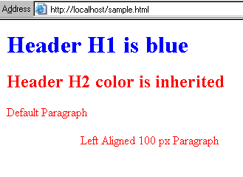
Example
<html>
<head>
<link rel="stylesheet"
type="text/css" href="sample.css" />
</head>
<body>
<h1>Header H1 is blue</h1>
<h2>Header H2 color is inherited</h2>
<p>Default Paragraph</p>
<p class="left" >Left Aligned 100 px Paragraph</p>
</body>
</html>
body {color: red}
h1 {color: blue}
p.left {margin-left: 100px}
Sample.html
Sample.css
IT2756 Copyrights © Nanyang Polytechnic

Slide 23
CSS Basics
Id Selector
  IDs are similar to Classes, except once a specific id has been declared it cannot be used again within the same HTML file.
  In general,
    IDs are used to style the layout elements of a page that will only be needed once
    Classes are used to style text and such that may be declared multiple times.

Slide 24
CSS Basics
  #menu1{
  width: 80%;
  margin: auto;
  padding: 20px;
  }
Id Selector
  Id Selectors starts with a #
Guideline: Use ID instead of Classes for styling your web site for example, side menu, banner etc
  id selector is chosen for the “menu1" division over a class, because it is used once within this file.
<div id=“menu1"> </div>

Slide 25
CSS Basics
Referencing a CSS file
  To reference a CSS file from a HTML or aspx file,
<head>
<link rel="stylesheet" type="text/css“ href=“sitestyle.css" />
</head>

Slide 26
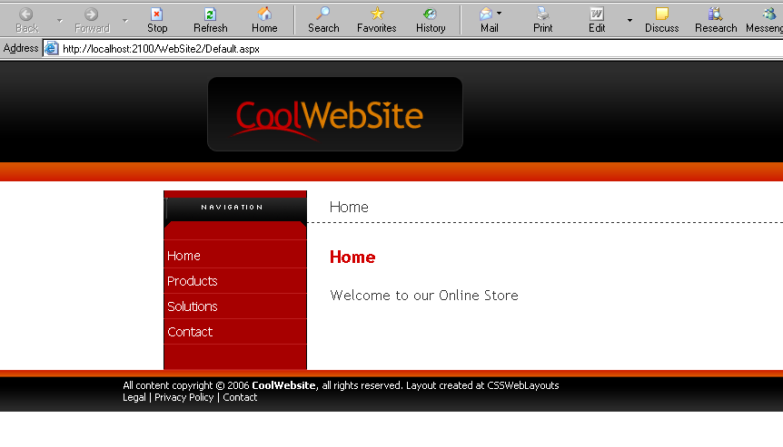
Cascading Style Sheets : Example
Demo MasterPage

Slide 27
Bootstrap

Slide 28
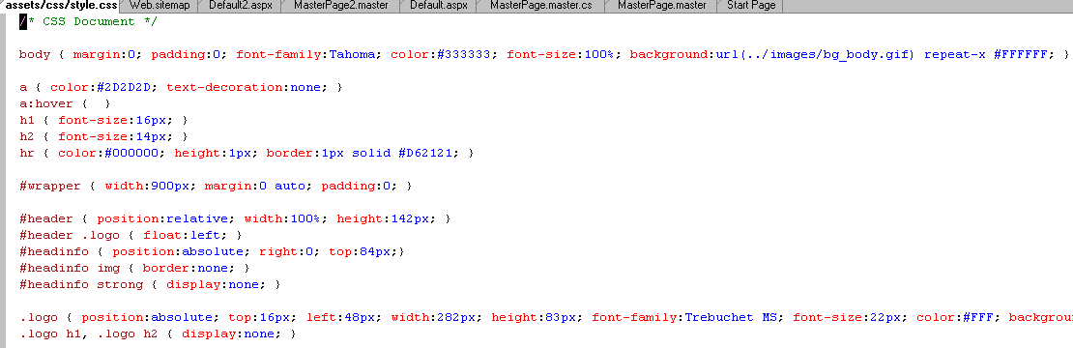
Cascading Style Sheets : Example
Partial CSS file

Slide 29
What is Bootstrap
Bootstrap is the most popular HTML, CSS, and JavaScript framework for developing responsive, mobile-first web sites.
Bootstrap is completely free
All ASP.Net web templates are built on Bootstrap framework (CSS, Styling, Fonts)
ASP.NET templates let you build a responsive Web site that looks good on mobile devices, tablets and PCs. The templates use the Bootstrap CSS Framework, which makes it really easy to build a responsive Web site and has great theming support

Slide 30
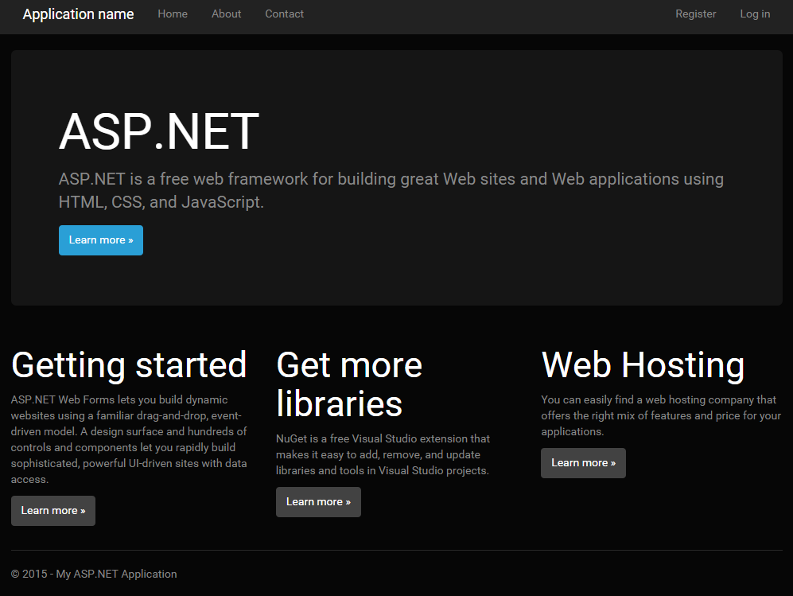
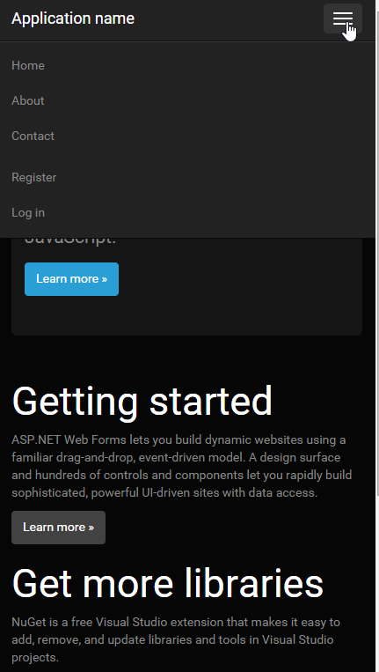
Bootstrap framework takes care of different device layouts. Eg. Laptop, Tablet or Mobile

Slide 31
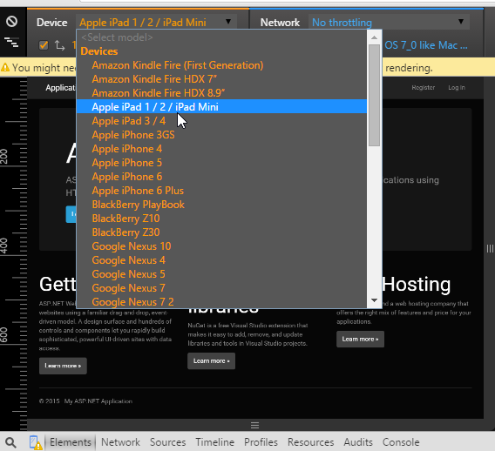
Use Chrome or IE to test your app on the different devices.
In chrome –
Right click – Inspect element
Click on the Handphone icon to launch the emulator tab. After that choose the appropriate device to test your app output on different devices.

Slide 32
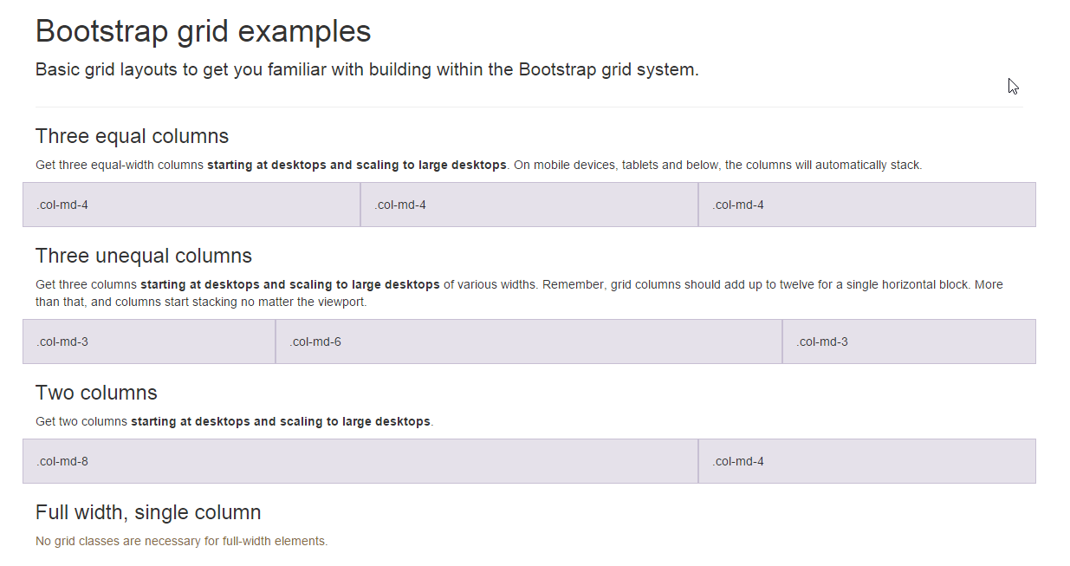
Bootstrap uses a Grid System Framework
This is necessary for a responsive design (i.e. To cater for different layout demands of different sized devices.
http://getbootstrap.com/examples/grid/

Slide 33
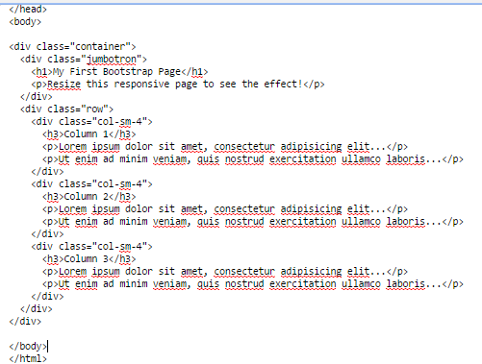
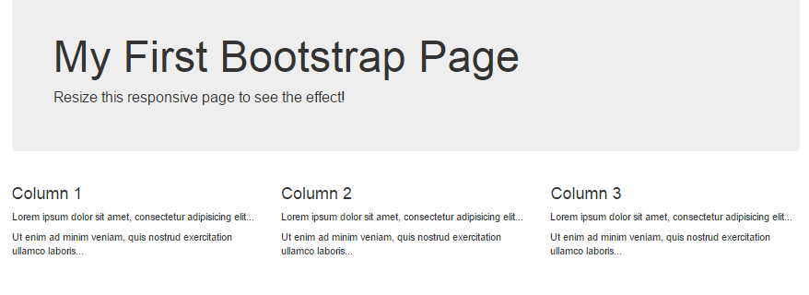
Example 1 – Columns (4-4-4)
Bootstrap uses predefined CSS classes
Here, we define different column sizes to make up the 12 column grid system

Slide 34
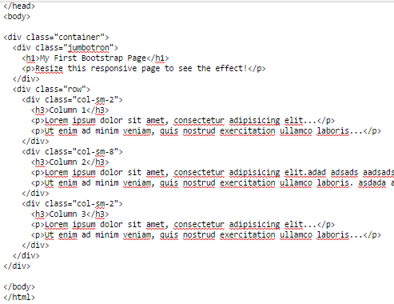
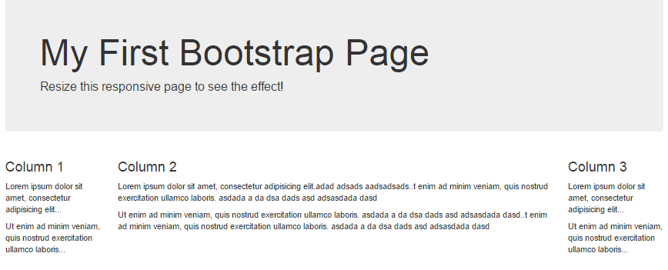
Example 2 – Columns (2-8-2)
Bootstrap uses predefined CSS classes
Here, we define different column sizes to make up the 12 column grid system

Slide 35
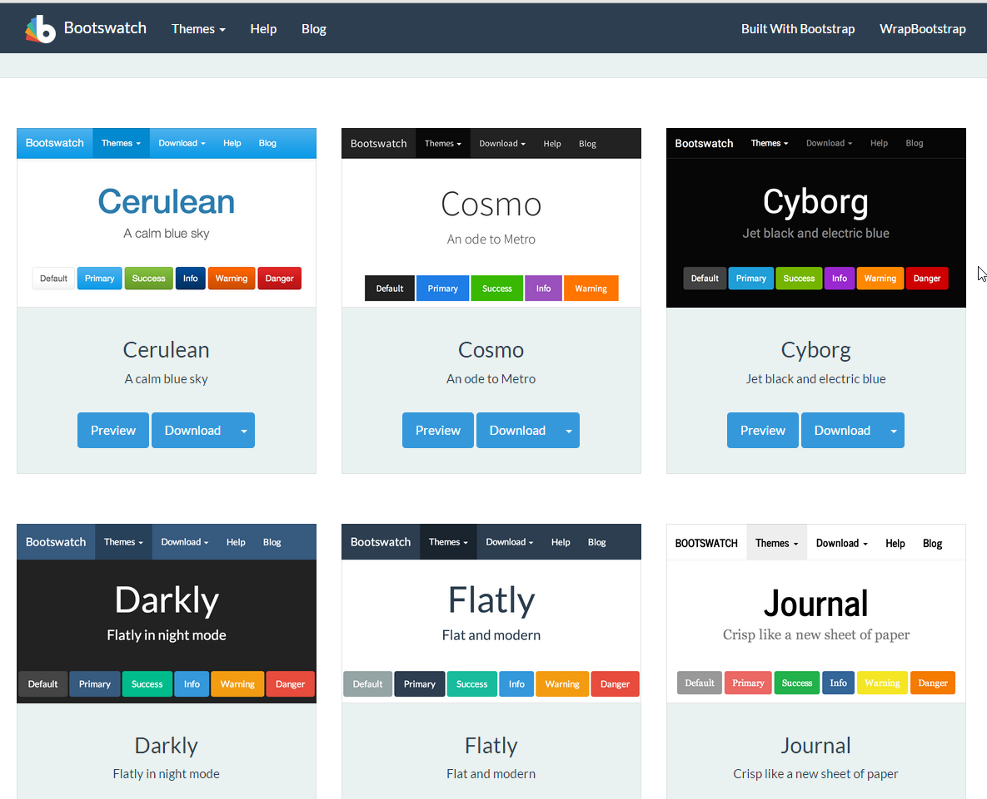
Bootstrap Resources
Different CSS / Style sets for your Website.
https://bootswatch.com/
Just download and replace bootstrap.css in content folder to change styles

Slide 36
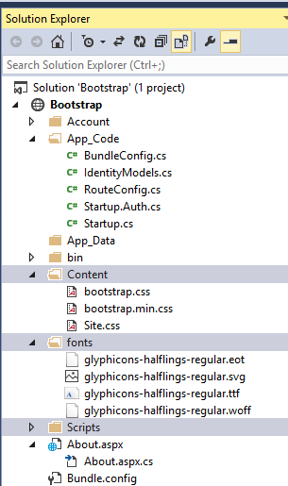
Where are bootstrap stored in Web App Project?
The project / App that you create on .net already have the bootstrap package installed.
Otherwise you can download as bootstrap package and install it in your project. The package contains the following folders:
  Fonts - containing the fonts used by your CSS theme
  Content – all the Css definition for your web app
  Scripts – Javascript files/Jquery files associated with the interactive parts of your web app.
  App_code – will contain some files (Eg. BundleConfig.cs) that consolidates all the CSS and JS files to optimize your web app performance

Slide 37
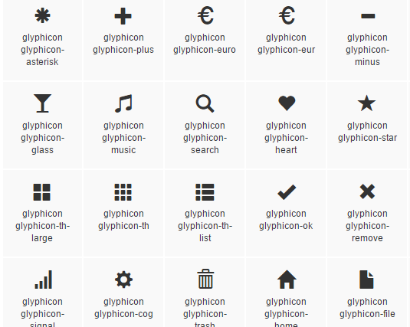
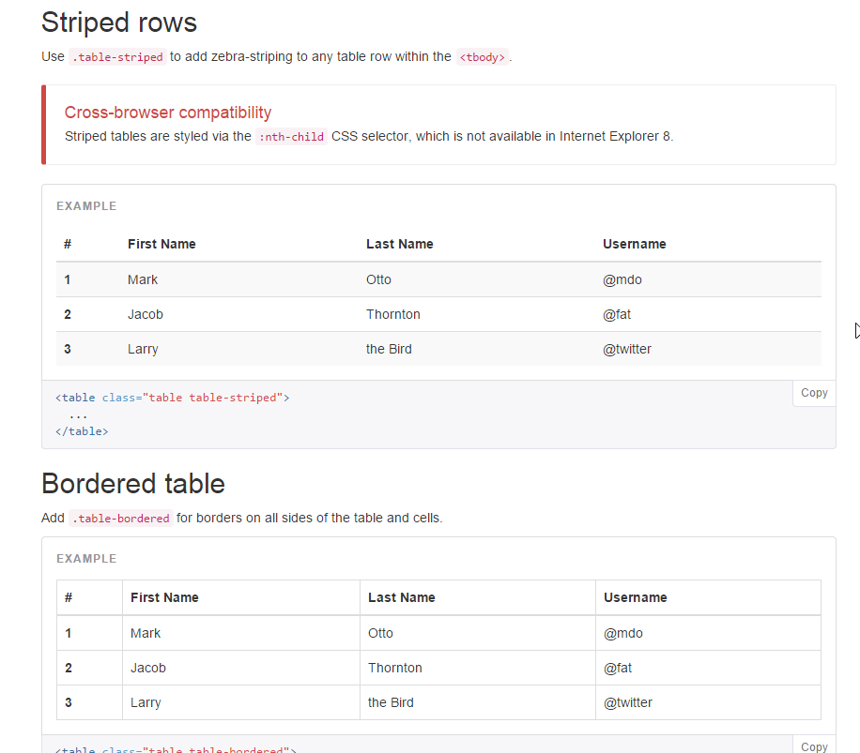
How useful?
Define Glyphicons
Define Layout (using the column grid systems)
Define your table, form, button styles
Dealing with images – to auto resize due to different layouts
Validation states, interactive components, and many more
Explore more at http://getbootstrap.com/

Slide 38
Where to get bootstrap?
 | http://getbootstrap.com/
Why Bootstrap? 6min
https://youtu.be/314m7YBRFvQ?list=PL6n9fhu94yhXd4xnk-j5FGhHjUv1LsF0V
Why Explained? 5min
https://www.youtube.com/watch?v=GU6EWzBGo64

Slide 39
Wait there’s more! Introducing
Materialize
http://materializecss.com/
Demo
https://www.youtube.com/watch?v=sDARfYsFRd0
Examples sites using Materialize
https://www.youtube.com/watch?v=13DOUHwH-iM
How about a Carousel?
https://www.youtube.com/watch?v=nsKi9xPU-AE

